Slide 1
IBM University Engagement Project Submission
“Exploring the Power of Agentic AI with IBM Granite and LangFlow”

Slide 2

Project Title – [Intelligent Market Research Assistant using Agentic AI]
Domain of Project – [ Business Intelligence / Market Research ]
Student Name | Recent Passport Photo | Email ID | Mobile number [WhatsApp]
Prof. Karan Padhiyar |  | karan.padhiyar@bvmengineering.ac.in | 9638022641

Slide 3
Problem Statement -
Problem Statement : Nutrition Agent
The Challenge
Organizations and startups often struggle with fragmented and rapidly changing market data such as customer feedback, competitor activities, analyst reports, industry publications, and social media trends. This information is scattered across multiple sources, making it difficult and time-consuming to analyze. Businesses need a solution that can not only gather information but also synthesize, predict, and generate actionable insights for smarter decision-making.
The Objective
Build an Agentic AI-powered Market Research Assistant that:
Collects data from multiple sources.
Performs competitor and sentiment analysis.
Forecasts market trends.
Generates business intelligence reports.
Provides visual dashboards for decision-makers.
Delivers real-time alerts for market changes.

Slide 4
Technology Used
Tech Stack (Mandatory)
Used approaches: LangFlow + IBM watsonx.ai + IBM Granite Models
Frontend
Streamlit Dashboard
Responsive User Interface
AI & LLM
IBM Granite 4.0-8B-Instruct
IBM watsonx.ai
Workflow Orchestration
LangFlow
Knowledge Retrieval
Retrieval Augmented Generation (RAG)
Vector Database
ChromaDB
Backend
Python
FastAPI
Cloud Platform
IBM Cloud
Data Sources
News APIs
Customer Reviews
Social Media Feeds
Industry Reports

Slide 5
Proposed Solution -
AI-Powered Intelligent Market Research Assistant
The proposed solution is a multi-agent market intelligence platform built using LangFlow, IBM watsonx.ai, and IBM Granite Models.
The system continuously gathers market-related information from trusted sources and uses Retrieval-Augmented Generation (RAG) to retrieve relevant knowledge before generating insights.
Core Functions
Market Trend Analysis
Competitor Intelligence
Customer Sentiment Analysis
Industry Monitoring
Demand Forecasting
Executive Report Generation
Benefits
Faster market research
Better business decisions
Reduced manual effort
Real-time market monitoring

Slide 6
Langflow component Used -
1. Chat Input
Accepts user queries.
2. URL Loader
Collects market reports and online content.
3. File Loader
Loads uploaded reports and research documents.
4. Text Splitter
Chunks documents for processing.
5. IBM Embedding Model
Creates vector embeddings.
6. ChromaDB Vector Store
Stores market knowledge vectors.
7. Retriever Component
Retrieves relevant information.
8. IBM Granite Model
Generates insights and reports.
9. Agent Component
Coordinates specialized agents.
10. Prompt Template
Structures AI prompts.
11. Chat Output
Displays final results.

Slide 7
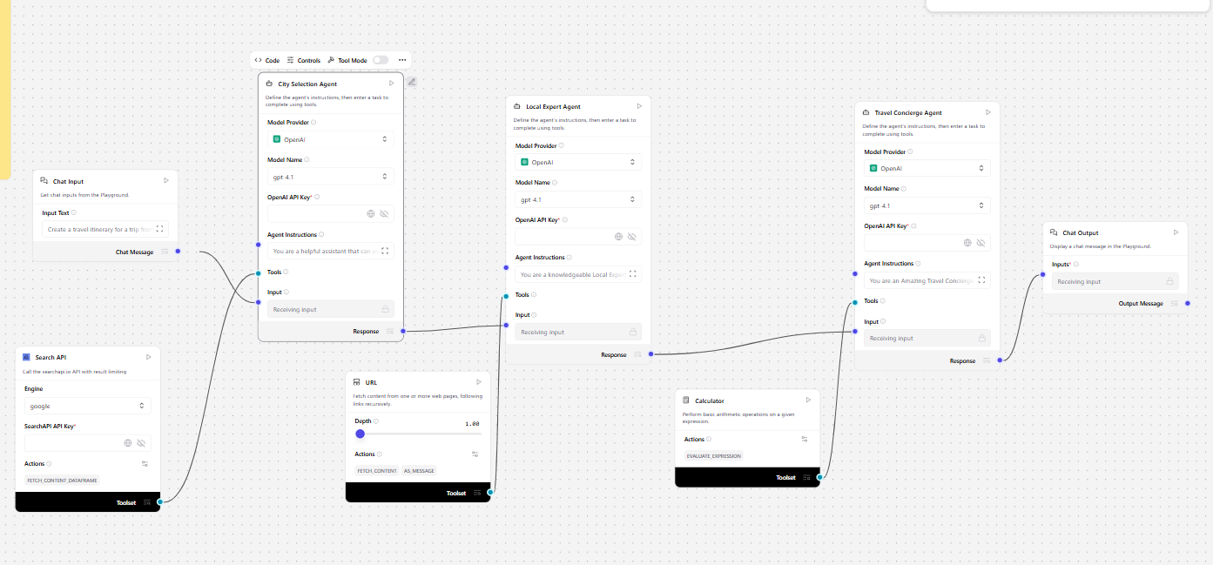
Langflow workflow -

Slide 8

Architecture blueprint

Slide 9

Role of Agentic AI in the solution
Role of Agentic AI in the Solution
Agentic AI enables autonomous market research by allowing multiple intelligent agents to collaborate.
Key Contributions
Autonomous data collection
Intelligent competitor tracking
Continuous sentiment monitoring
Market trend prediction
Automated report generation
Real-time decision support
Advantages
Reduced human effort
Improved accuracy
Faster analysis
Proactive recommendations

Slide 10
Technology Used
Technology | Purpose
LangFlow | Workflow orchestration
IBM watsonx.ai | AI deployment
IBM Granite 4.0 | Reasoning and generation
ChromaDB | Vector storage
RAG | Knowledge retrieval
Python | Backend development
Streamlit | Dashboard
IBM Cloud | Hosting and scalability

Slide 11
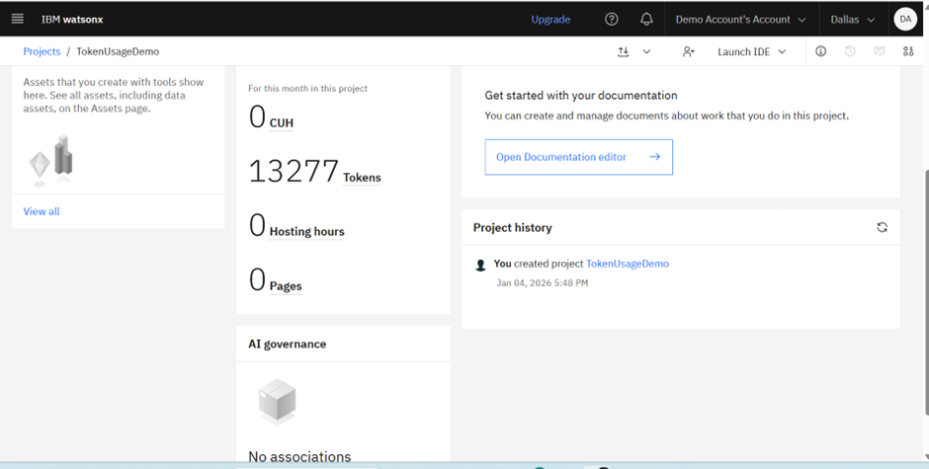
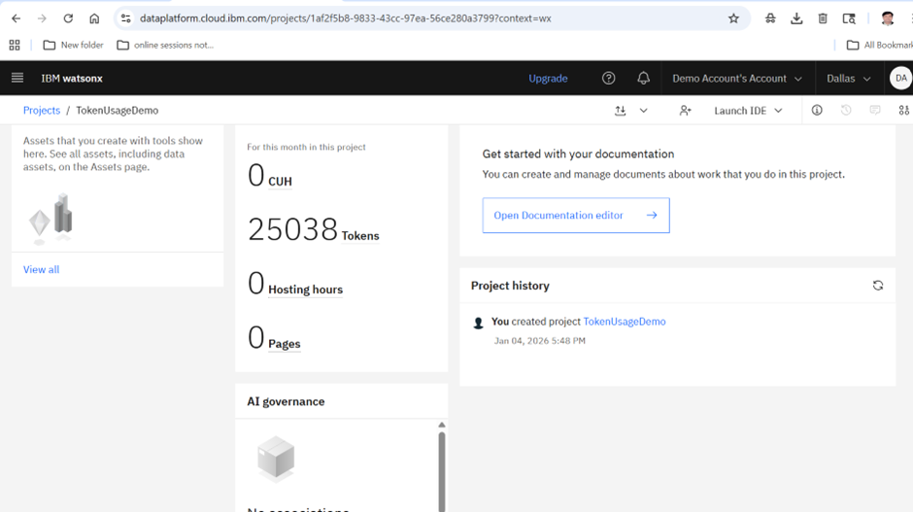
Token Usage
11,761 token are used
Dashboard Modules Market Pulse
Industry trends
Emerging opportunities
Competitor Tracker
Product launches
Pricing changes
Customer Sentiment
Positive/Negative sentiment
Demand Forecast
Growth projections
Executive Summary
Strategic recommendations
·
·
·

Slide 12
Novelty and Uniqueness
Novel Features
Multi-Agent Intelligence : Multiple specialized AI agents collaborate.
RAG-Based Market Research : Accurate and trustworthy information retrieval.
Predictive Analytics : Forecasts future trends and opportunities.
Real-Time Monitoring : Tracks market changes continuously.
Multimodal Input : Supports documents, text, charts, and voice notes.
Automated Executive Reports : Generates ready-to-use business insights.
IBM Enterprise AI Stack : Built using IBM Granite and watsonx.ai.

Slide 13
Git Hub Link
Github URL : https://github.com/karan514451/intelligent-market-research-assistant
·
·
·

Slide 14
Future Scope
1. CRM Integration
Connect Salesforce, HubSpot, and Zoho.
2. Real-Time Financial Market Analysis
Monitor stocks and economic indicators.
3. Voice-Based Research Assistant
Enable conversational market intelligence.
4. Multilingual Research Support
Analyze global markets in multiple languages.
5. AI-Powered Competitive Benchmarking
Automated competitor ranking.
6. Predictive Investment Intelligence
Identify high-growth sectors and opportunities.
7. Automated Strategic Recommendations
Suggest business actions based on market changes.
8. Mobile Application
Access insights from anywhere.
·
·
·

Slide 15


